Slide 1

Penguins in Antarctica
Shashidhar Reddy – Final Project

Slide 2
Problem
When data on penguins in Antarctica is acquired each year, it is difficult to glean conclusions from the raw data and compare statistics across time.
Our objective is to make it easier to detect clusters and features of these penguins from data, so that insights may be gained more effectively when we sample these penguins in the future.

Slide 3
The approach
Our solution to this challenge is to develop a clustering method that will aid in data organization and visualization of penguin groupings and features.
To do this we use:
K-means clustering to organize and illustrate the clusters.
Hierarchical clustering to visualize the characteristics of the penguins in these clusters.
This method will make comparing traits and clusters over time simpler..

Slide 4
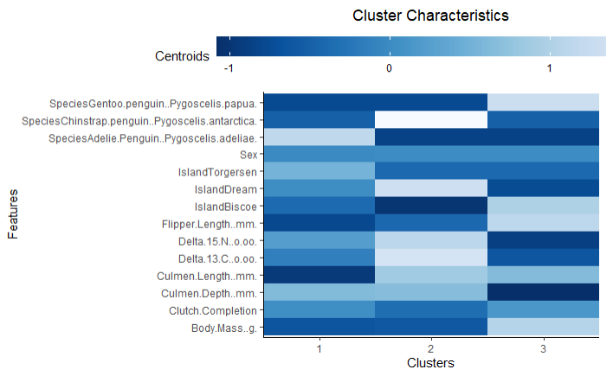
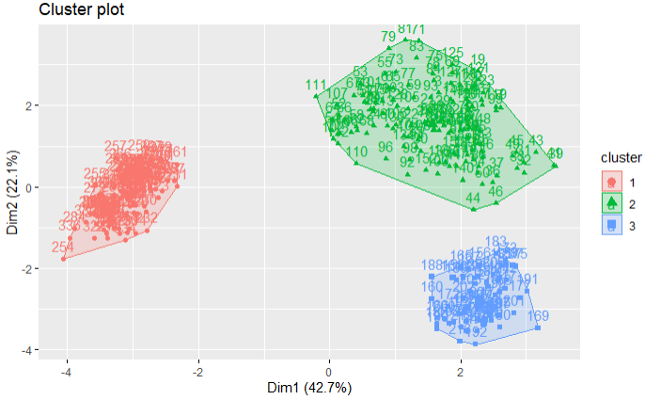
The Results
The algorithm generates two main graphs that are easy to comprehend and can be used to compare results over time.

